Slide 1





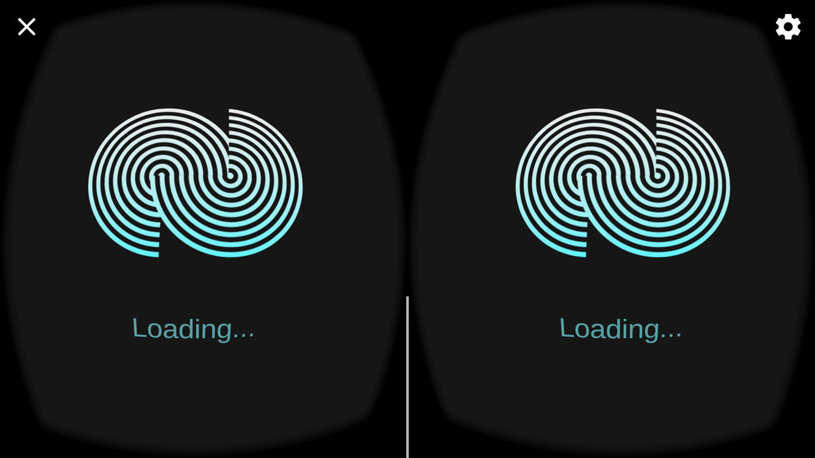
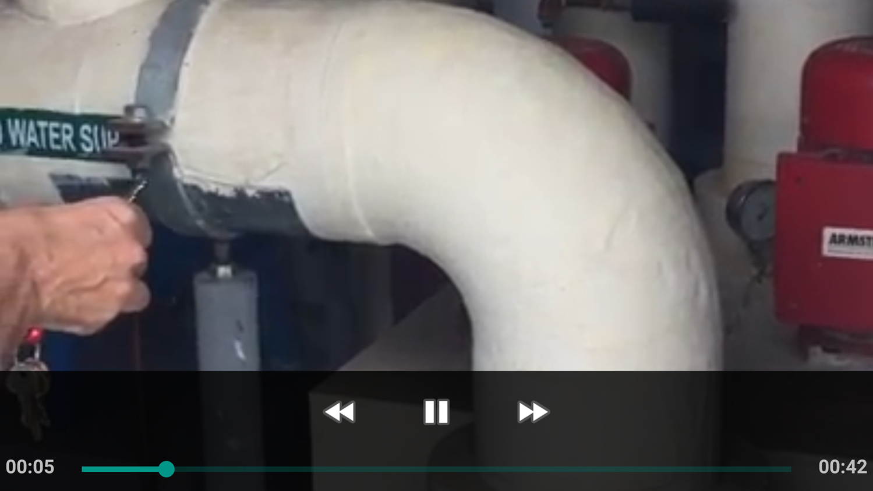
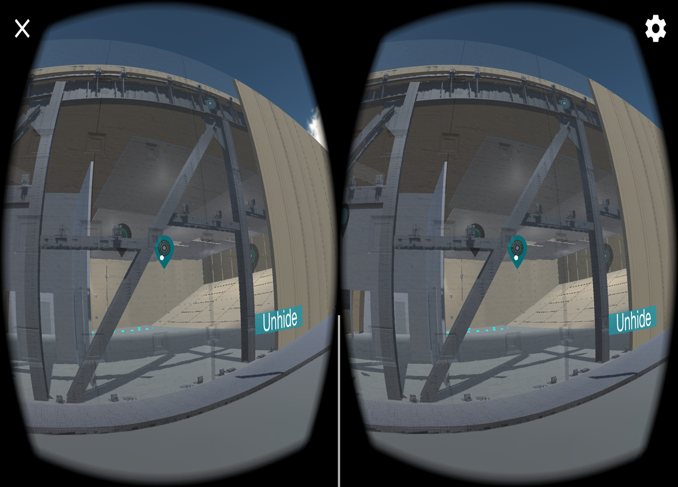
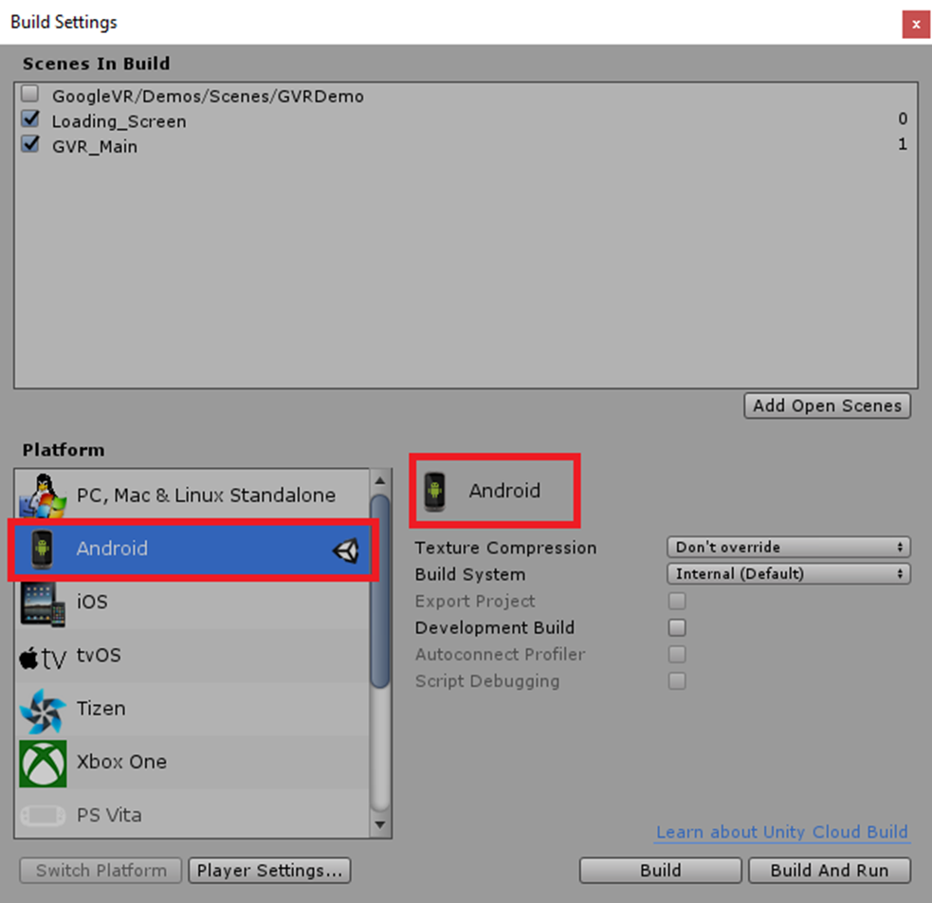



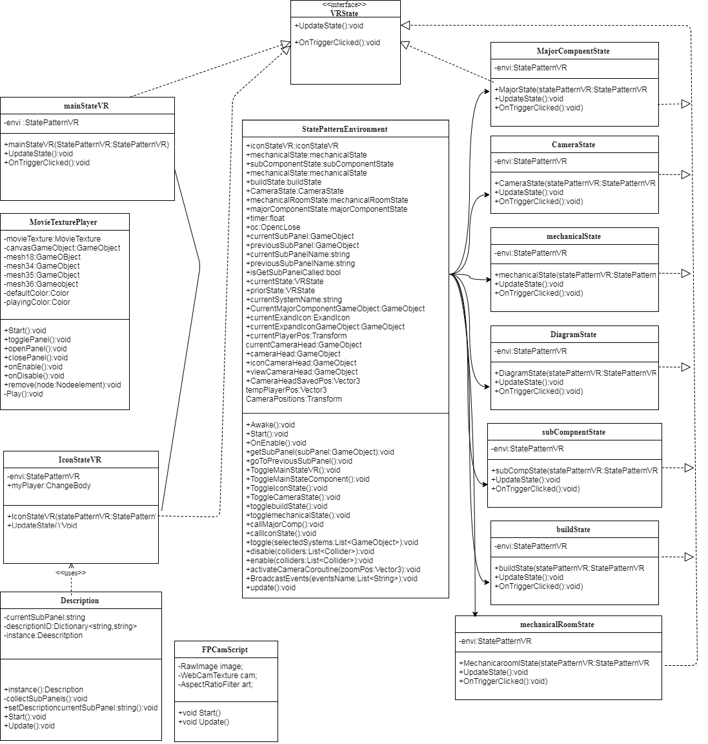

School of Computing & Information Sciences
Senior Project, 2017, Summer
Learning With Virtual Reality
Student: Deon Davis, Florida International University
Mentor: Dr. Francisco Ortega, Dr. Shahin Vassigh, Florida International University
Instructor: Masoud Sadjadi, Florida International University
Problem
Unable to differentiate between application loading and application freeze.
Unable to view videos when interacting with environment.
Android optimization and resolving compatibility issues.
Icons disappear from camera.
VR view missing.
Solution
Create a loading screen to notify user that it is still loading. (1)
Resolved lack of capabilities to open videos when interacting with icons. (2)
Build to android and fixed bugs that arose (4)
Display icon by having a separate camera. (3)
Use VR SDK to show the VR POV. (1 and 3)
Current System
System now has a loading screen with a loading animation to indicate it is loading.
Videos are now able to be played on the application.
Icons are now being shown and can be clicked on.
The VR view is now enabled.
Player can move
Problem
Solution
Current System
Screenshots
Screenshots
1
Loading Screen
2
Video
3
Icon View
4
Android Build
Requirements
Ability to play videos when clicking on icons.
Loading screen continues to play until main scene is finished rendering.
Icons now display to camera when it is in line of sight.
The application can display the VR point of view.
The application can be built to Android with functional features.
Implementation
Requirements
System Design
Unity Game Engine used for models and controllers
Developed for Android
Object Design
Visual Studio 2017 for framework and editing.
Object Design
Application is written in C# scripts.
Verification
ID: Learning_VR_LoadingScreen
Purpose:
To serve as a method that informs the user the application is still loading.
Preconditions:
The user has installed the application.
The user has launched the application.
The application is currently in the loading phase.
Expected Output:
The loading screen continues its animation while the main scene loads. Scene changes when loading is completed.
Summary
The Skope VR application for mobile now minimally supports most functionality of its Unity PC counterpart.
The ability to interact with the environment and explore it is possible on mobile devices.
The application is now capable of being demoed and distributed for real use and public testing.
Other minor quality of life changes were implemented.
Verification
Summary
Acknowledgement
The material presented in this poster is based upon the work supported by Albert Elias and Shahin Vassign. I am thankful to the help that I received from my group member, Edvin Li.
Notes:
1

